Slide 1
Disconnected cooperation in resilient networks and the algorithmic challenges of local fast re-routing
Stefan Schmid

Slide 2
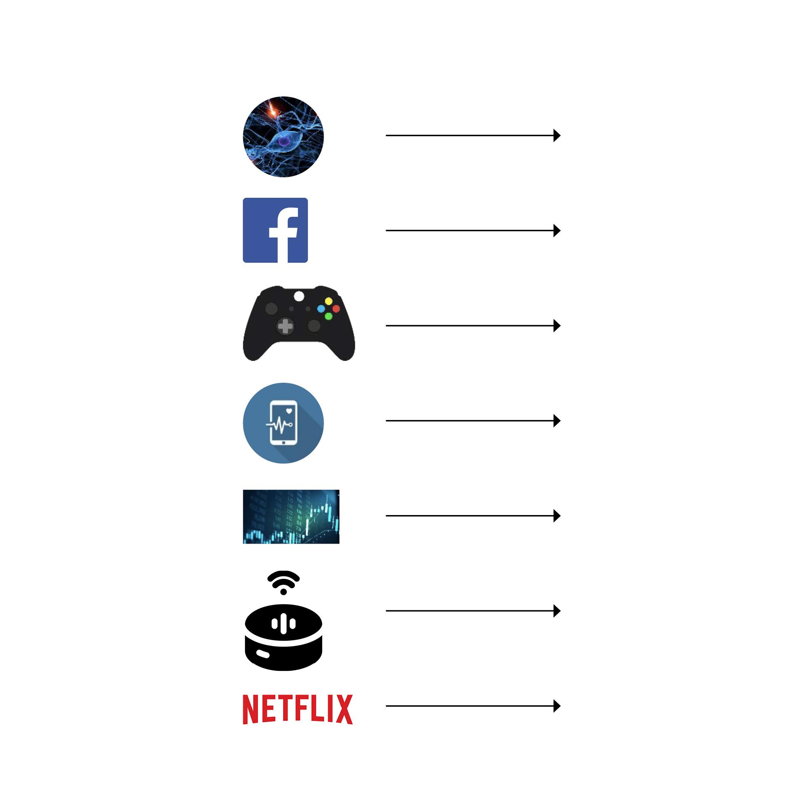
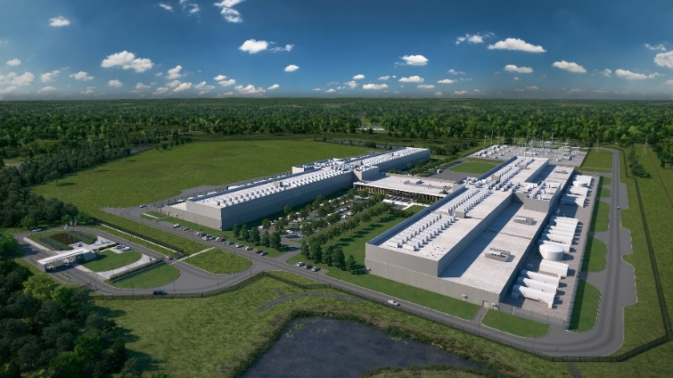
Communication Networks
Critical infrastructure of digital society
Popularity of datacentric applications: health, business, entertainment, social networking, AI/ML, etc.
Evident during ongoing pandemic: online learning, online conferences, etc.
Much traffic especially to, from, and inside datacenters
Facebook datacenter
Increasingly stringent dependability requirements!
1

Slide 3

Roadmap
A Brief Background on Resilient Networking
Algorithms for Local Fast Re-Routing (FRR)
Accounting for Congestion
Accounting for Network Policy

Slide 4
Roadmap
A Brief Background on Resilient Networking
Algorithms for Local Fast Re-Routing (FRR)
Accounting for Congestion
Accounting for Network Policy

Slide 5
Traditional Networks
Routing
Algorithm
control
plane
data
plane
Distributed algorithms: upon link failure, reconverge to shortest paths
8

Slide 6
Software-Defined Networks (SDN)
Remote Controller
control
plane
data
plane
CA
CA
CA
CA
CA
Centralized algorithms: upon link failure, push new forwarding rules
Faster and more controlled reaction: a reason for Google’s move to SDN!

Slide 7

Software-Defined Networks (SDN)
Remote Controller
Still slow…
control
plane
data
plane
CA
CA
CA
CA
CA
Centralized algorithms: upon link failure, push new forwarding rules
Faster and more controlled reaction: a reason for Google’s move to SDN!

Slide 8
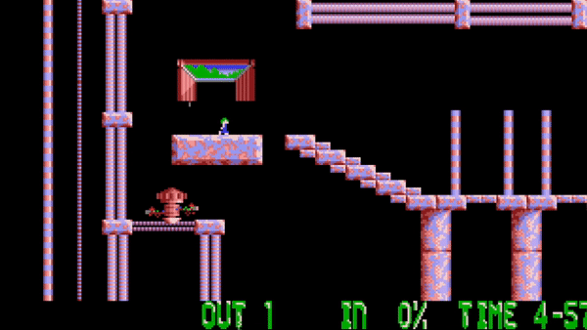

Restoration in control plane takes time -> packet drops!
routing restoration
Video shot taken from “Lemmings” designed and developed by DMA Design
Notes:
well, when a link disrupt a path, ww need to reconfigure the forwarding tables in the network to reroute the traffic onto another path. This operations actually takes time and meanwhile packets are being dropped.

Slide 9


Failover: Control Plane vs Data Plane
Slower reaction in the control plane than in the data plane
vs
Minister of Education
Teacher in the Classroom
11

Slide 10
Approaches for Failover
In Control Plane
In Data Plane
Distributed recomputation of shortest paths (“re-convergence”)
Centralized recomputation of paths (SDN)
Link-reversal algorithms (e.g., Gafni et al.)
vs
Static forwarding table
Rules pre-installed before failures are known
12

Slide 11
Approaches for Failover
In Control Plane
In Data Plane
Slow but “globally informed”.
Fast but “local knowledge”.
Distributed recomputation of shortest paths (“re-convergence”)
Centralized recomputation of paths (SDN)
Link-reversal algorithms (e.g., Gafni et al.)
vs
Static forwarding table
Rules pre-installed before failures are known
12

Slide 12
The FRR Problem
Phase 1: Rule installation
13

Slide 13
The FRR Problem
Phase 1: Rule installation
if x fwd to y
13

Slide 14
The FRR Problem
Phase 1: Rule installation
Phase 2: Failures and routing
if x fwd to y
13

Slide 15
The FRR Problem
Phase 1: Rule installation
Phase 2: Failures and routing
if x fwd to y
Without coordination!
13

Slide 16
The FRR Problem
Default route
Pre-installed local-fast failover rules
Can depend on local failures and, e.g., destination, inport, source
At runtime, rules are just ”executed”
t
Advantage: no need to wait for reconvergence.
s
Credits: Klaus-Tycho Förster
14

Slide 17
The FRR Problem
Good alternative under 1 failure!
Pre-installed local-fast failover rules
Can depend on local failures and, e.g., destination, inport, source
At runtime, rules are just ”executed”
t
Advantage: no need to wait for reconvergence.
s
Pre-installed failover rule
Credits: Klaus-Tycho Förster
14

Slide 18
The FRR Problem
Good alternative under 1 failure!
Pre-installed local-fast failover rules
Can depend on local failures and, e.g., destination, inport, source
At runtime, rules are just ”executed”
t
Advantage: no need to wait for reconvergence.
s
Does not see 2nd failure…
Credits: Klaus-Tycho Förster
14

Slide 19
The FRR Problem
Can get complex under multiple failures..
Pre-installed local-fast failover rules
Can depend on local failures and, e.g., destination, inport, source
At runtime, rules are just ”executed”
t
Advantage: no need to wait for reconvergence.
s
Requires inport matching!
Credits: Klaus-Tycho Förster
14

Slide 20
The FRR Problem
With global knowledge: simpler!
Pre-installed local-fast failover rules
Can depend on local failures and, e.g., destination, inport, source
At runtime, rules are just ”executed”
t
Advantage: no need to wait for reconvergence.
s
Credits: Klaus-Tycho Förster
14

Slide 21

What information is locally available in a switch for handling a packet?
Credits: Marco Chiesa
15

Slide 22
Locally Available Information:
The Forwarding Table: Match -> Action
Forwarding table
match
action
Credits: Marco Chiesa
15

Slide 23
Locally Available Information:
The Packet Header
Forwarding table
header
match
action
Credits: Marco Chiesa
15

Slide 24
Locally Available Information:
The Inport of the Received Packet
int0
int2
Forwarding table
header
match
action
int1
int3
Credits: Marco Chiesa
15

Slide 25

Locally Available Information:
The Outgoing Port Depends on Failed Links
int0
int2
Forwarding table
header
match
action
int1
int3
Credits: Marco Chiesa
15

Slide 26
Raises an Interesting Question
Can we pre-install local fast failover rules which ensure reachability under multiple failures? In particular: How many failures can be tolerated by static forwarding tables?
16

Slide 27
Roadmap
A Brief Background on Resilient Networking
Algorithms for Local Fast Re-Routing (FRR)
Accounting for Congestion
Accounting for Network Policy

Slide 28
So: How many failures can be tolerated by static forwarding tables?
Credits: Marco Chiesa
19

Slide 29
If we partition the network, there is not much to do
Credits: Marco Chiesa
19

Slide 30
The connectivity k of a network 𝑁: the minimum number of link deletions that partitions 𝑁
The connectivity of this network is four
Credits: Marco Chiesa
19

Slide 31
Resilience Criteria
Ideal resilience
Given a k-connected graphs, we can tolerate any k-1 link failures.
Perfect resilience
Any source s can always reach any destination t as long as the unterlying network is physically connected.
Can this be achieved? Assume undirected link failures.
20

Slide 32
Resilience Criteria
Ideal resilience
Given a k-connected graphs, we can tolerate any k-1 link failures.
Perfect resilience
Any source s can always reach any destination t as long as the unterlying network is physically connected.
Can this be achieved? Assume undirected link failures.
20

Slide 33
Spectrum of Models
int0
int2
Recall our switch model:
Forwarding table
header
match
action
int1
int3
Achievable resilience depnds on what can be matched:
Per-destination | Per source | Incoming port | Probabilistic forwarding | Packet header rewriting
Credits: Marco Chiesa
21

Slide 34
Spectrum of Models
int0
int2
Recall our switch model:
Forwarding table
header
match
action
int1
int3
Can carry global information, but often undesirable
Achievable resilience depnds on what can be matched:
Per-destination | Per source | Incoming port | Probabilistic forwarding | Packet header rewriting
Credits: Marco Chiesa
21

Slide 35

Per-destination routing cannot cope with even one link failure
Per-destination | Per source | Incoming port | Probabilistic forwarding | Packet header rewriting | Resiliency
X |  |  |  |  | 0
t
Pre-computed failover path
Without matching inport: sends back – loop!
s
22

Slide 36
Can we achieve k – 1 resiliency in k-connected graph here?
Per-destination | Per source | Incoming port | Probabilistic forwarding | Packet header rewriting | Resiliency
X | X | X |  |  | ?
s
t
Credits: Marco Chiesa
23

Slide 37
Can we achieve k – 1 resiliency in k-connected graph here?
Per-destination | Per source | Incoming port | Probabilistic forwarding | Packet header rewriting | Resiliency
X | X | X |  |  | Yes
k disjoint paths: try one after the other, routing back to source each time.
s
t
Credits: Marco Chiesa
24

Slide 38
Can we achieve k – 1 resiliency in k-connected graph here?
Per-destination | Per source | Incoming port | Probabilistic forwarding | Packet header rewriting | Resiliency
X |  | X |  |  | ?
What about this scenario? Practically important. From now on called “ideal resilience”.
25

Slide 39
Ideal Resilience: Example 2-dim Torus?
26

Slide 40
Ideal Resilience: Example 2-dim Torus?
k=4 connected: tolerate 3 failures?
26

Slide 41
Idea: Decomposition into Hamilton Cycles
Decompose torus into 2-edge-disjoint Hamilton Cycles (HC)
Can route in both directions: 4-arc-disjoint HCs
3-resilient routing to destination d:
go along 1st directed HC, if hit failure, reverse direction
if again failure switch to 2nd HC, if again failure reverse direction
No more failures possible!
1st Hamilton cycle
26

Slide 42
Idea: Decomposition into Hamilton Cycles
Decompose torus into 2-edge-disjoint Hamilton Cycles (HC)
Can route in both directions: 4-arc-disjoint HCs
3-resilient routing to destination d:
go along 1st directed HC, if hit failure, reverse direction
if again failure switch to 2nd HC, if again failure reverse direction
No more failures possible!
1st Hamilton cycle
2nd Hamilton cycle
26

Slide 43
Idea: Decomposition into Hamilton Cycles
Decompose torus into 2-edge-disjoint Hamilton Cycles (HC)
Can route in both directions: 4-arc-disjoint HCs
3-resilient routing to destination d:
go along 1st directed HC, if hit failure, reverse direction
if again failure switch to 2nd HC, if again failure reverse direction
No more failures possible!
d
26

Slide 44
Idea: Decomposition into Hamilton Cycles
Decompose torus into 2-edge-disjoint Hamilton Cycles (HC)
Can route in both directions: 4-arc-disjoint HCs
3-resilient routing to destination d:
go along 1st directed HC, if hit failure, reverse direction
if again failure switch to 2nd HC, if again failure reverse direction
No more failures possible!
3-resilient routing to destination d:
go along 1st directed HC, if hit failure, reverse direction
if again failure switch to 2nd HC, if again failure reverse direction
No more failures possible!
d
26

Slide 45
Ideal Resilience with Hamilton Cycles
Chiesa et al.: if k-connected graph has k arc disjoint Hamilton Cycles, k-1 resilient routing can be constructed!
What about graphs which cannot be decomposed into Hamilton cycles?
Chiesa et al. On the Resiliency of Static Forwarding Tables. IEEE/ACM Transactions on Networking (ToN), 2017.

Slide 46
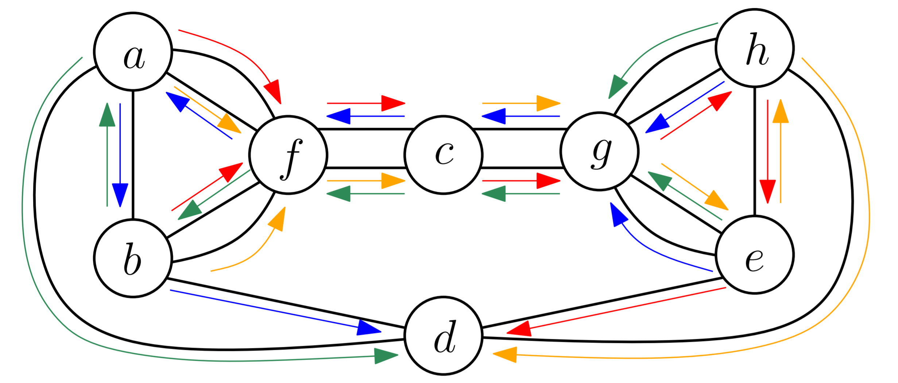
Ideal Resilience in General k-Connected Graphs
Use directed trees (i.e. arborescences) instead of Hamilton cycles
Arc-disjoint, spanning, and rooted at destination
Classic result: k-connectivity guarantees k-arborescence decomposition
4-connected,
4 arborescences
Basic idea:
Idea: route towards root on one arborescence
After failure: change arborescence (e.g. in circular fashion)
Incoming port defines current arborescence
After k-1 failures: At least one arborescence intact
J. Edmonds, Edge-disjoint branchings. Combinatorial Algorithms, 1972.

Slide 47
Ideal Resilience in General k-Connected Graphs
Use directed trees (i.e. arborescences) instead of Hamilton cycles
Arc-disjoint, spanning, and rooted at destination
Classic result: k-connectivity guarantees k-arborescence decomposition
4-connected,
4 arborescences
Basic idea:
Idea: route towards root on one arborescence
After failure: change arborescence (e.g. in circular fashion)
Incoming port defines current arborescence
After k-1 failures: At least one arborescence intact
The challenge: how to avoid earlier tree?
J. Edmonds, Edge-disjoint branchings. Combinatorial Algorithms, 1972.

Slide 48
A k-connected network contains k arc-disjoint spanning arborescences [Edmonds, 1972]
t
Credits: Marco Chiesa
29

Slide 49
A k-connected network contains k arc-disjoint spanning arborescences [Edmonds, 1972]
t
Credits: Marco Chiesa
29

Slide 50
A k-connected network contains k arc-disjoint spanning arborescences [Edmonds, 1972]
t
Credits: Marco Chiesa
29

Slide 51
A k-connected network contains k arc-disjoint spanning arborescences [Edmonds, 1972]
t
Credits: Marco Chiesa
29

Slide 52
A k-connected network contains k arc-disjoint spanning arborescences [Edmonds, 1972]
t
Credits: Marco Chiesa
29

Slide 53
A k-connected network contains k arc-disjoint spanning arborescences [Edmonds, 1972]
t
Credits: Marco Chiesa
29

Slide 54

General technique: routing along the same tree
t
Credits: Marco Chiesa
30

Slide 55

When a failed link is hit…
t
Credits: Marco Chiesa
30

Slide 56
… how do we choose the next arborescence?
t
Credits: Marco Chiesa
30

Slide 57
But how do we choose the next arborescence?
Circular-arborescence routing:
compute an order of the arborescences
switch to the next arborescence when hitting a failed link
31

Slide 58
Circular arborescence-routing is (k/2-1)-resilient
t
Arborescence order
1
2
3
4
Intuition: each single failure may affect two arborescences
Credits: Marco Chiesa
32

Slide 59
Circular arborescence-routing is (k/2-1)-resilient
t
Arborescence order
1
2
1
2
3
4
Intuition: each single failure may affect two arborescences
Go along arborescence 1 to destination...
Credits: Marco Chiesa
32

Slide 60
Circular arborescence-routing is (k/2-1)-resilient
t
Arborescence order
1
2
1
2
3
4
Intuition: each single failure may affect two arborescences
Go along arborescence 2 to destination...
Credits: Marco Chiesa
32

Slide 61
Circular arborescence-routing is (k/2-1)-resilient
t
Arborescence order
1
2
1
2
3
4
Intuition: each single failure may affect two arborescences
Go along arborescence 3 to destination...
Credits: Marco Chiesa
32

Slide 62
Circular arborescence-routing is (k/2-1)-resilient
t
Arborescence order
1
2
1
2
3
4
Intuition: each single failure may affect two arborescences
Go along arborescence 4 to destination...
Credits: Marco Chiesa
32

Slide 63
Circular arborescence-routing is (k/2-1)-resilient
t
Arborescence order
1
2
1
2
3
4
Intuition: each single failure may affect two arborescences
All k=4 arborescences used
(2 failures disconnected
affected all four):
LOOP!
Credits: Marco Chiesa
32

Slide 64
An Alternative Algorithm: Bouncing Arborescence
Bouncing-arborescence algorithm:
Reroute on the tree that shares the failed link
This algorithm is 1-resilient.
33

Slide 65
Bouncing-Arborescence is 1-Resilient
d
Start with red…
Credits: Marco Chiesa
34

Slide 66
Bouncing-Arborescence is 1-Resilient
d
… bounce to yellow…
Credits: Marco Chiesa
34

Slide 67
Bouncing-Arborescence is 1-Resilient
d
… bounce to red (again!)…
LOOP!
Credits: Marco Chiesa
34

Slide 68

Idea: Bounce on „Good Arborescences“
d
Define well-bouncing arc:
When bounce get to the destination
Without hitting any other failures
(3,1) is not well-bouncing
(1,3) is well-bouncing
Define good tree:
every failed arc is well-bouncing
Red is not a good tree
Blue, Yellow, and Green are good trees
1
2
3
4
5
Credits: Marco Chiesa
34

Slide 69

Idea: Bounce on „Good Arborescences“
d
Define well-bouncing arc:
When bounce get to the destination
Without hitting any other failures
(3,1) is not well-bouncing
(1,3) is well-bouncing
Define good tree:
every failed arc is well-bouncing
Red is not a good tree
Blue, Yellow, and Green are good trees
1
2
3
4
5
Credits: Marco Chiesa
34

Slide 70
Idea: Bounce on „Good Arborescences“
d
Define well-bouncing arc:
When bounce get to the destination
Without hitting any other failures
(3,1) is not well-bouncing
(1,3) is well-bouncing
Define good tree:
every failed arc is well-bouncing
Red is not a good tree
Blue, Yellow, and Green are good trees
1
2
3
4
5
Credits: Marco Chiesa
34

Slide 71
Idea: Bounce on „Good Arborescences“
d
Define well-bouncing arc:
When bounce get to the destination
Without hitting any other failures
(3,1) is not well-bouncing
(1,3) is well-bouncing
Define good arborescence:
every failed arc is well-bouncing
Red is not a good tree
Blue, Yellow, and Green are good trees
1
2
3
4
5
Credits: Marco Chiesa
34

Slide 72
Idea: Bounce on „Good Arborescences“
d
Define well-bouncing arc:
When bounce get to the destination
Without hitting any other failures
(3,1) is not well-bouncing
(1,3) is well-bouncing
Define good arborescence:
every failed arc is well-bouncing
Red is not a good arborescence
Blue, Yellow, and Green are good trees
1
2
3
4
5
Credits: Marco Chiesa
34

Slide 73
Idea: Bounce on „Good Arborescences“
d
Define well-bouncing arc:
When bounce get to the destination
Without hitting any other failures
(3,1) is not well-bouncing
(1,3) is well-bouncing
Define good arborescence:
every failed arc is well-bouncing
Red is not a good arborescence
Blue is a good arboresence
1
2
3
4
5
Credits: Marco Chiesa
34

Slide 74
Ideas
One can show that there is always a good arborescence
An tempting idea:
route on an arborescence X until a failed link is hit:
if X is a good arborescence, bounce!
otherwise, route circular
Too good to be true:
The “goodness” of an arborescence depends on the actual set of failed links!
How do we know a arborescence is good?
Credits: Marco Chiesa
35

Slide 75
Resilience Criteria
Ideal resilience
Given a k-connected graphs, we can tolerate any k-1 link failures.
Perfect resilience
Any source s can always reach any destination t as long as the unterlying network is physically connected.
Can this be achieved? Assume undirected link failures.
36

Slide 76
Resilience Criteria
Perfect resilience is impossible to achieve in general.
37

Slide 77
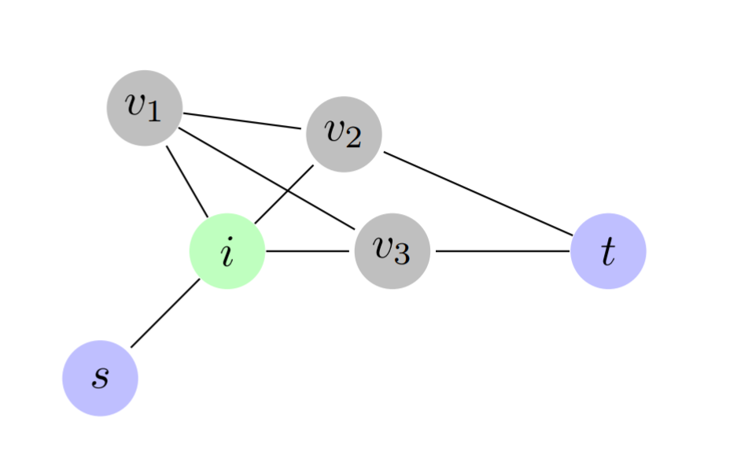

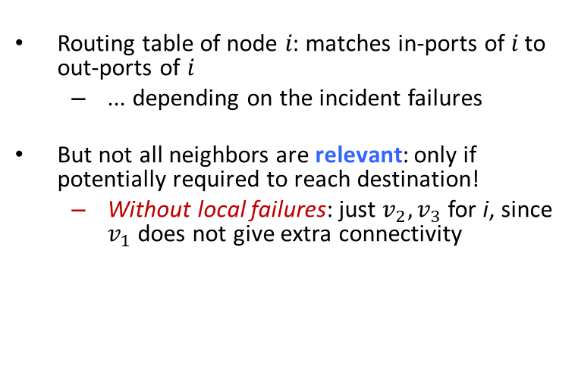
Relevant Neighbors
Routing table of node 𝑖: matches in-ports of 𝑖 to out-ports of 𝑖
... depending on the incident failures
But not all neighbors are relevant: only if potentially required to reach destination!
Without local failures: just $v_{2},v_{3}$ for i, since $v_{1}$does not give extra connectivity
With additional failures 𝑣₁ becomes relevant, since 𝑣₁ might be only choice to reach destination 𝑡
Note: 𝑣₁ is unaware of these non-incident failures!
Same for 𝑣3
38

Slide 78
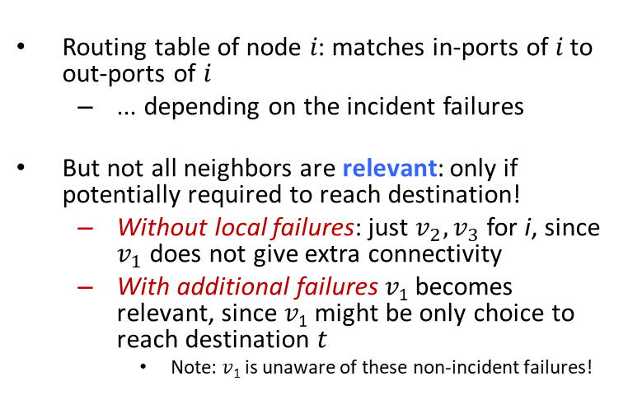
Relevant Neighbors
Routing table of node 𝑖: matches in-ports of 𝑖 to out-ports of 𝑖
... depending on the incident failures
But not all neighbors are relevant: only if potentially required to reach destination!
Without local failures: just $v_{2},v_{3}$ for i, since $v_{1}$does not give extra connectivity
With additional failures 𝑣₁ becomes relevant, since 𝑣₁ might be only choice to reach destination 𝑡
Note: 𝑣₁ is unaware of these non-incident failures!
Same for 𝑣3
High-level definition of relevant: From the local view-point of the node 𝑖, a relevant neighbor might be only neighbor to reach destination (without taking a detour over a current neighbor).
38

Slide 79
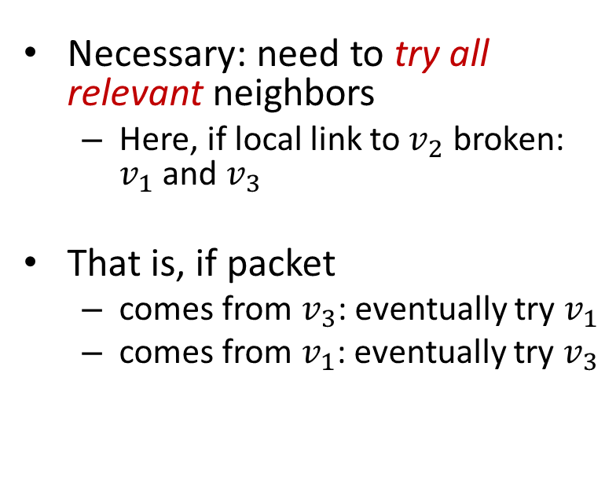
How to Achieve Perfect Resilience?
Necessary: need to try all relevant neighbors
Here, if local link to $v_{2}$ broken: $v_{1}$ and $v_{3}$
That is, if packet
comes from $v_{3}$: eventually try $v_{1}$
comes from $v_{1}$: eventually try $v_{3}$
39

Slide 80
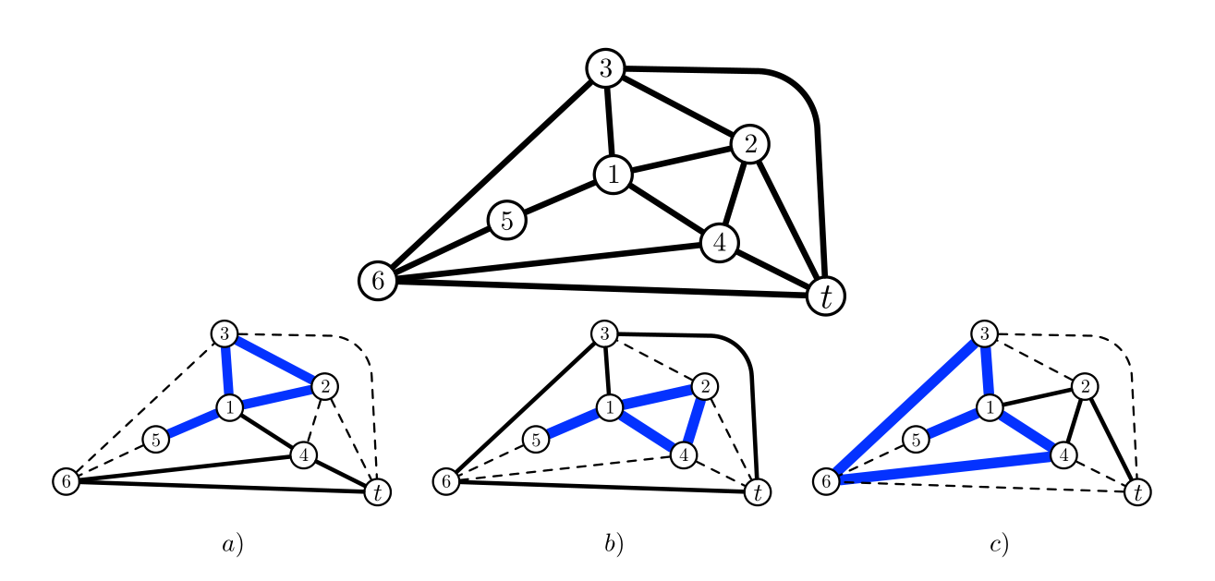
Impossibility: On Planar Graphs
Some observations:
Additional failures only add relevant neighbors to nodes
Any node of degree 2 of G after failures must forward packets with incoming port p to port p'
If all neighbors are relevant, the forwarding function of a node must be a cyclic permutation
40

Slide 81
Impossibility: On Planar Graphs
Some observations:
Additional failures only add relevant neighbors to nodes
Any node of degree 2 of G after failures must forward packets with incoming port p to port p'
If all neighbors are relevant, the forwarding function of a node must be a cyclic permutation
Idea of the counter example:
All neighbors of all nodes are relevant (even without failures).
So we must fix a permutation for node 1.
Considered node 1 will not see any local failures.
8
41

Slide 82
Why does it have to be a permutation? Because each incoming neighbor could be the source, and I need to send it to each remaining relevant neighbor (it could be the only one left).

Slide 83
Impossibility: On Planar Graphs
Some observations:
Additional failures only add relevant neighbors to nodes
Any node of degree 2 of G after failures must forward packets with incoming port p to port p'
If all neighbors are relevant, the forwarding function of a node must be a cyclic permutation
Proof idea, with three cases:
If the dashed links fail (non-local to node 1), in any forwarding pattern, packets will be stuck in one of the blue loops…
… even though there is at least one remaining path to the target
Go through all possible permutations @1 and give counter example.
42

Slide 84
Impossibility: On Planar Graphs
Arriving on inport 5, forwarded to 2.
For node 1:
5->2 implies
(5,2,3,4) (b)
(5,2,4,3) (a)
Possible cyclic permutations: when a packet arrives from 2, due to cyclic permutation, it can only be forwarded to either 3 or 4. Leads to loops in scenarios (b) (4 goes to 5, 2 can only go to 4) and (a) (3 goes to 5, 2 can only go to 3), respectively.
43

Slide 85
Impossibility: On Planar Graphs
Arriving on inport 5, forwarded to 3.
Possible cyclic permutations: when a packet then arrives on port 4, it can only be forwarded to either 2 or 5. Leads to loops in scenarios (a) (2 will go to 5, 5 can only go to 1 and 3 only to 2) and (c) (5 goes to 3, 4 goes to 5, rest degree-2), respectively.
For node 1:
5->2 implies
(5,2,3,4) (b)
(5,2,4,3) (a)
For node 1:
5->3 implies
(5,3,4,2) (a)
(5,3,2,4) (c)
43

Slide 86
Impossibility: On Planar Graphs
Arriving on inport 5, forwarded to 4.
For node 1:
5->2 implies
(5,2,3,4) (b)
(5,2,4,3) (a)
For node 1:
5->3 implies
(5,3,4,2) (a)
(5,3,2,4) (c)
For node 1:
5->4 implies
(5,4,2,3) (c)
(5,4,3,2) (b)
Possible cyclic permutations: packet arriving on port 3 can only be forwarded to either 5 or 2. Leads to loops in scenarios (c) and (b), respectively.
43

Slide 87
Impossibility: On Planar Graphs
Link needed: otherwise 5 would not be relevant!
For node 1:
5->2 implies
(5,2,3,4) (b)
(5,2,4,3) (a)
For node 1:
5->3 implies
(5,3,4,2) (a)
(5,3,2,4) (c)
For node 1:
5->4 implies
(5,4,2,3) (c)
(5,4,3,2) (b)
Possible cyclic permutations: packet arriving on port 3 can only be forwarded to either 5 or 2. Leads to loops in scenarios (c) and (b), respectively.
43

Slide 88
Impossibility
Case (i) Pi(5,leeremenge)=2: To ensure t1 (; ;) is a cyclic permutation under this constraint, a packet arriving on port 2 can only be forwarded to either 3 or 4. Thus the possible permutations are (5; 2; 3; 4) and (5; 2; 4; 3), which lead to loops under the failure sets illustrated in Figure 3.b and a.
Case (ii) t1 (5; ;) = 3. To ensure t1 (; ;) is a cyclic permutation under this constraint, a packet arriving on port 4 can only be forwarded to either 2 or 5. Thus the possible permutations are (5; 3; 4; 2) and (5; 3; 2; 4) which lead to loops under the failure sets illustrated in Figure 3.a and c.
Case (iii) t1 (5; ;) = 4. To ensure t1 (; ;) is a cyclic permutation under this constraint, a packet arriving o port 4 can only be forwarded to either 2 or 5. Thus the possible permutations are (5; 4; 3; 2) and (5; 4; 3; 2) which lead to loops under the failure sets illustrated in Figure 3.b and c.
Case (iv) t1 (5; ;) = 5 There is no cyclic permutation with this assignment, thus there would be a loop according to Lemma 3.1.
Hence there is exists no forwarding pattern without a failure set that causes a loop.

Slide 89
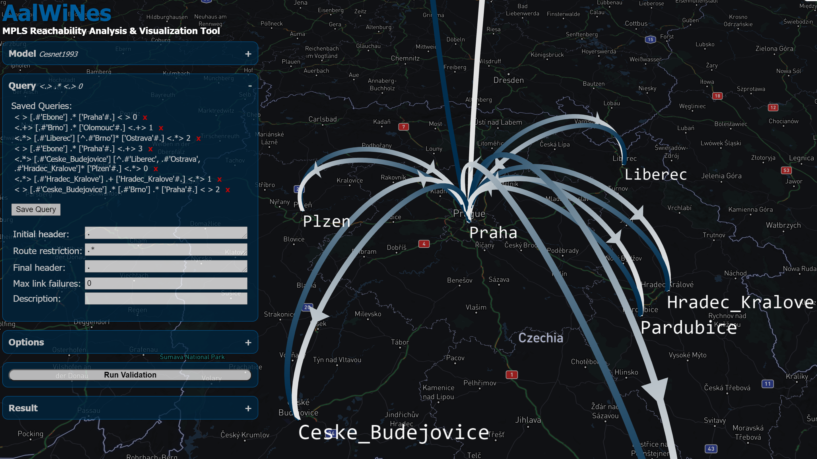
A Pity: Planar Graphs Are Important
Internet Topology Zoo and Rocketfuel topologies
88% of the graphs are planar
However:
Almost a third (32%) belong to the family of cactus graphs
Roughly half of the graphs (49%) are outerplanar
… and they work ☺
44

Slide 90
A Pity: Planar Graphs Are Important
Internet Topology Zoo and Rocketfuel topologies
88% of the graphs are planar
However:
Almost a third (32%) belong to the family of cactus graphs
Roughly half of the graphs (49%) are outerplanar
… and they work ☺
44

Slide 91
Where Can Perfect Resilience Be Achieved?
For example on outerplanar graphs:
Via geometric routing, well studied in sensor networks etc.
Embed graph in the plane s.t. all nodes are on the outer face
Note: If a link l belongs to the outer face of a planar graph G, it also belongs to the outer face for all subgraphs of G
Apply right-hand rule to forwarding (skipping failures)
Ensures packets use only the links of the outer face and do not change the direction despite failures
Strategy traverses all nodes on the outer face
Also works for any graph which is outerplanar without the source (e.g., K4)
44

Slide 92
Some Observations
𝐾_5, 𝐾_3,3: no perfect resilience
Perfect resiliency on graph G -> any subgraph G‘ of G also allows for perfect resiliency
Idea: Take routing on G, fail edges to create G‘, routing must still work
Contraction works as well, by a simulation argument
A bit technical
Combined: Perfect resilience on graph G -> any minor G‘ of G as well
But since 𝐾_5, 𝐾_3,3 not: non-planar graphs not perfectly resilient
u
v
uv
45

Slide 93
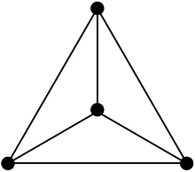
What we know about perfect resilience
Possible:
On all outerplanar graphs [right-hand rule]
On every graph that is outerplanar without the destination (e.g. non-outerplanar planar 𝐾_4 )
Impossible:
On some planar graphs
Every non-planar graph
Perfect resilience must hold on minors
u
v
uv
Foerster et al. On the Feasibility of Perfect Resilience with Local Fast Failover. SIAM Symposium on Algorithmic Principles of Computer Systems (APOCS), 2021.
8

Slide 94
Roadmap
A Brief History of Resilient Networking
Algorithms for Local Fast Re-Routing (FRR)
Accounting for Congestion
Accounting for Network Policy

Slide 95
Congestion-Aware FRR
A most simple network:
the clique
1
t
2
5
3
4
48

Slide 96
Congestion-Aware FRR
A most simple network:
the clique
1
t
2
Assume we can match source.
5
3
4
48

Slide 97
Congestion-Aware FRR
Traffic demand:
{1,2,3}->t
1
t
2
5
3
Without failures!
4

Slide 98
Congestion-Aware FRR
Traffic demand:
{1,2,3}->t
1
t
2
Assume single destination (incast scenario).
5
3
Without failures!
4

Slide 99
Congestion-Aware FRR
Failover table:
flow 1->t: 2,3,4,5,…
Traffic demand:
{1,2,3}->t
1
Failover table:
flow 1->t: 3,4,5,…
flow 2->6: 3,4,5,…
t
2
Failover table:
flow 1->t: 4,5,…
flow 2->6: 3,4,5,…
flow 3->6: 4,5,…
5
3
Preinstalled failover rules
for red flow
Don‘t try 2 or 1: loop! So go along a permutation!
4
49

Slide 100
Congestion-Aware FRR
Failover table:
flow 1->t: 2,3,4,5,…
Traffic demand:
{1,2,3}->t
1
Failover table:
flow 1->t: 3,4,5,…
flow 2->t: 3,4,5,…
t
2
Failover table:
flow 1->t: 4,5,…
flow 2->t: 4,5,…
flow 3->t: 4,5,…
5
3
Preinstalled failover rules
for red, blue and green flows
4
49

Slide 101
Congestion-Aware FRR
Failover table:
flow 1->t: 2,3,4,5,…
Traffic demand:
{1,2,3}->t
1
Failover table:
flow 1->t: 3,4,5,…
flow 2->t: 3,4,5,…
t
2
Failover table:
flow 1->t: 4,5,…
flow 2->t: 4,5,…
flow 3->t: 4,5,…
5
3
Preinstalled failover rules
for red, blue and green flows
4
49

Slide 102
Congestion-Aware FRR
Failover table:
flow 1->t: 2,3,4,5,…
Traffic demand:
{1,2,3}->t
1
Failover table:
flow 1->t: 3,4,5,…
flow 2->t: 3,4,5,…
t
2
Failover table:
flow 1->t: 4,5,…
flow 2->t: 4,5,…
flow 3->t: 4,5,…
5
3
Finally, t is reached!
4
49

Slide 103
Congestion-Aware FRR
Failover table:
flow 1->t: 2,3,4,5,…
Traffic demand:
{1,2,3}->t
1
Failover table:
flow 1->t: 3,4,5,…
flow 2->t: 3,4,5,…
t
2
Max load is 3 ☹
Failover table:
flow 1->t: 4,5,…
flow 2->t: 4,5,…
flow 3->t: 4,5,…
5
3
4
49

Slide 104
Congestion-Aware FRR
Failover table:
flow 1->t: 2,3,4,5,…
Traffic demand:
{1,2,3}->t
1
Failover table:
flow 1->t: 5,…
flow 2->t: 3,4,5,…
t
2
A better solution:
load 2 ☺
Failover table:
flow 1->t: 4,5,…
flow 2->t: 4,5,…
flow 3->t: 4,5,…
5
3
4
49

Slide 105
Congestion-Aware FRR
Failover table:
flow 1->t: 2,3,4,5,…
Traffic demand:
{1,2,3}->t
1
Failover table:
flow 1->t: 5,…
flow 2->t: 3,4,5,…
t
2
Observation: we can represent failover tables as a matrix. To load balance: prefixes of rows should be different!
Failover table:
flow 1->t: 4,5,…
flow 2->t: 4,5,…
flow 3->t: 4,5,…
5
3
4
49

Slide 106
Failover Matrix Representation
Failover table:
flow 1->t: 2,3,4,5,…
Traffic demand:
{1,2,3}->t
1
Failover table:
flow 1->t: 3,4,5,…
flow 2->t: 3,4,5,…
t
2
Matrix:
source 1: 2,3,4,5
source 2: 3,4,5,1
source 3: 4,5,1,2
Failover table:
flow 1->t: 4,5,…
flow 2->t: 4,5,…
flow 3->t: 4,5,…
5
3
4
50

Slide 107
Failover Matrix Representation
Failover table:
flow 1->t: 2,3,4,5,…
Traffic demand:
{1,2,3}->t
1
Failover table:
flow 1->t: 3,4,5,…
flow 2->t: 3,4,5,…
t
2
Matrix:
source 1: 2,3,4,5
source 2: 3,4,5,1
source 3: 4,5,1,2
Failover table:
flow 1->t: 4,5,…
flow 2->t: 4,5,…
flow 3->t: 4,5,…
Problem: failing link (3,t) will affect all three rerouted flows… In general: easy to create high load on node 4, as failures can be „reused“.
5
3
4
50

Slide 108
What Are Good Failover Matrices?
The matrices should be Latin squares: each node appears exactly once on each row and each column. No repetitions implies loop-freedom.
Latin squares property gives high resilience, but is not sufficient for minimizing load.
51

Slide 109
Challenging Example: Incast
Traffic demand:
{1,2,3,4,5}->t
1
t
2
In the following, consider all-to-one demand pattern.
5
3
4
49

Slide 110
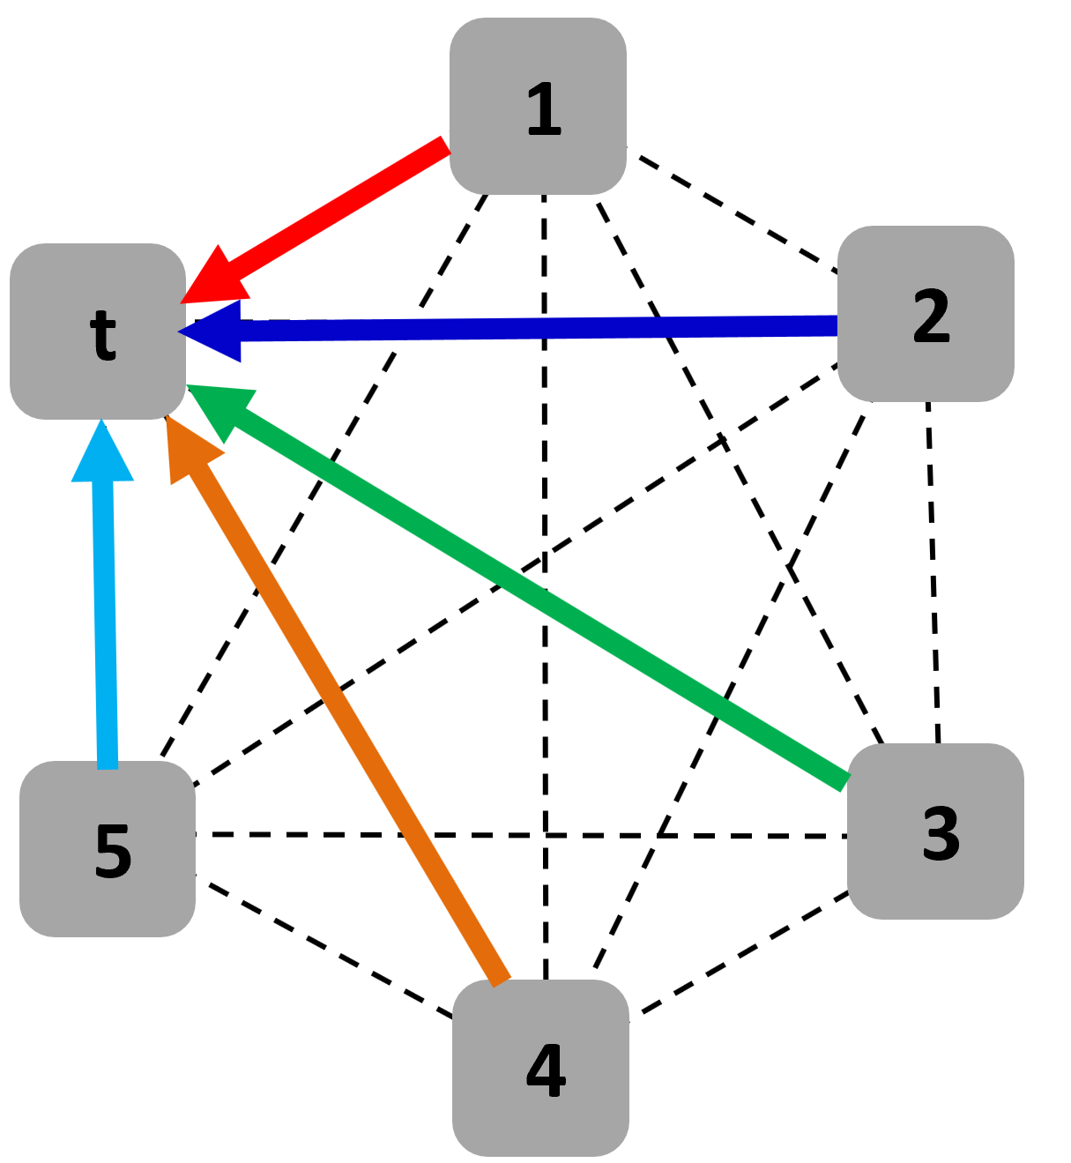
A Bad Matrix for Load
Src 1:
2 | 3 | 4 | 5
3 | 4 | 5 | 1
4 | 5 | 1 | 2
5 | 1 | 2 | 3
1 | 2 | 3 | 4
Src 2:
Src 3:
Src 4:
Src 5:
52

Slide 111
A Bad Matrix for Load
Src 1:
2 | 3 | 4 | 5
3 | 4 | 5 | 1
4 | 5 | 1 | 2
5 | 1 | 2 | 3
1 | 2 | 3 | 4
Src 2:
Failing (1,t), (2,t), (3,t), (4,t), gives load 4 on node 5 / link (5,t).
Src 3:
Src 4:
Src 5:
If the adversary fails the l first links to destination d (that is, {(v_{i},t), i = 1, . . . , l}), then l sources will route through (v_{i+1},t). Load l for l failures. Can we do better?
52

Slide 112
Good Failover Matrices?
To bring the flow from a source i to a node X, need to fail all links in corresponding row
Worst case: all to destination
The same for each other flow/row which should reach X
Adversary will try to reuse link failures: good matrices have prefixes with little overlap (resp. large number of unique nodes)
 |  |  |  | X
 | X
 |  |  | X
 |  | X
 |  |  |  | X
 |  | X
i
53

Slide 113
Good Failover Matrices?
To bring the flow from a source i to a node X, need to fail all links in corresponding row
Worst case: all to destination
The same for each other flow/row which should reach X
Adversary will try to reuse link failures: good matrices have prefixes with little overlap (resp. large number of unique nodes)
 |  |  |  | X
 | X
 |  |  | X
 |  | X
 |  |  |  | X
 |  | X
i
53

Slide 114
Connection to Block Designs
A closely related problem: generating block designs
and its geometric counterpart, generating projective planes of high order
Using symmetric balanced incomplete block designs (BIBDs)
Gives a latin failover matrix M with intersection properties representing a failover scheme that is optimal up to a constant factor
Also used in the context disconnected cooperation, e.g.:
G. Malewicz, A. Russell, and A. A. Shvartsman. Distributed Scheduling for Disconnected Cooperation. Distributed Computing, 18(6), 2005.
54

Slide 115
Overview of Results
Good news: Theory of local algorithms without communication: symmetric block design theory.
Bad news (counting argument): High load unavoidable even in well-connected residual networks: a price of locality.
Given L failures, load at least √L, although network still highly connected (n-L connected). E.g., L=n/2, load could be 2 still, but due to locality at least √n.
Borokhovich et al. Load-Optimal Local Fast Rerouting for Dense Networks. IEEE/ACM Transactions on Networking (TON), 2018.

Slide 116

Randomized Failover
Recall: deterministic lower bound of √L for L failures, although load could be O(1) for L<L/2. A large price of locality.
So what about randomized approaches?
56

Slide 117
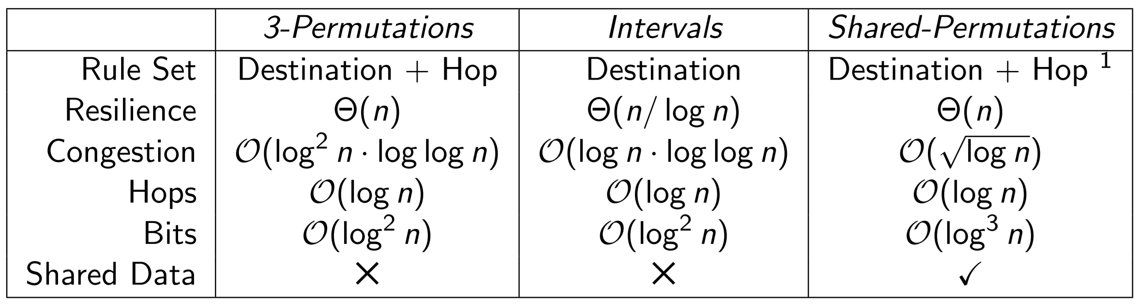
The Power of Randomization
While deterministic algorithms can at best achieve a polynomial load, randomized algorithms can achieve a polylogarithmic load.
Even when just matching the destination.
Losing a log n factor in resilience.
Matching also the hop count can overcome this.
Bankhamer et al. Local Fast Rerouting with Low Congestion: A Randomized Approach.
27th IEEE International Conference on Network Protocols (ICNP), 2019.

Slide 118
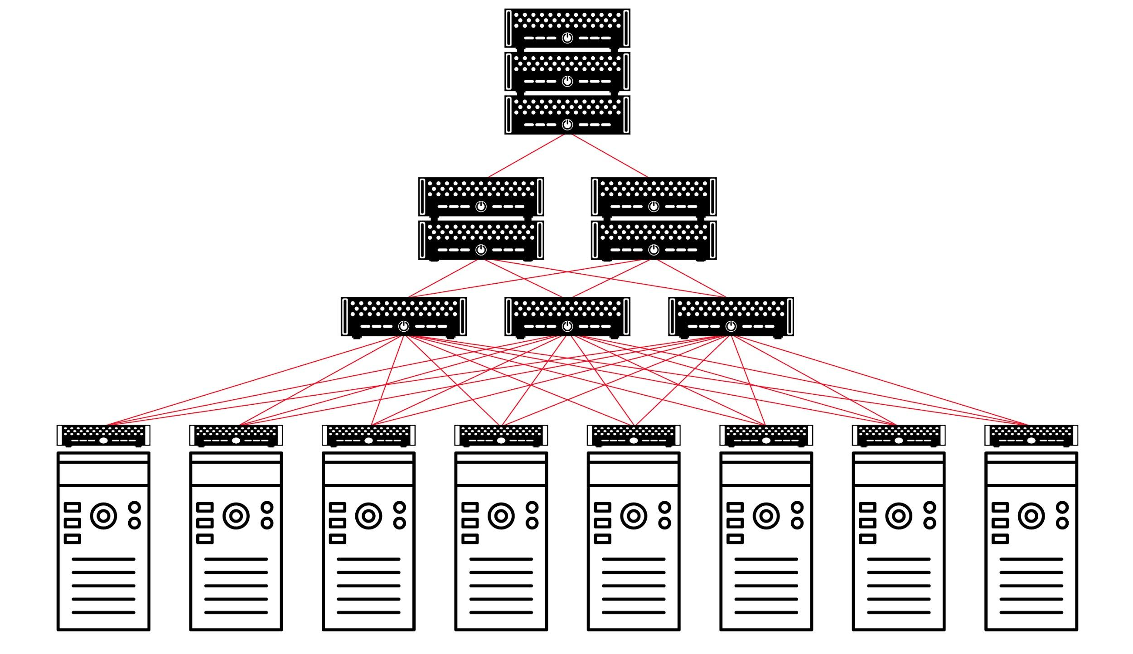
Benefits in Datacenter Networks
Bankhamer et al. Randomized Local Fast Rerouting for Datacenter Networks with Almost Optimal Congestion. DISC, 2021.
58

Slide 119
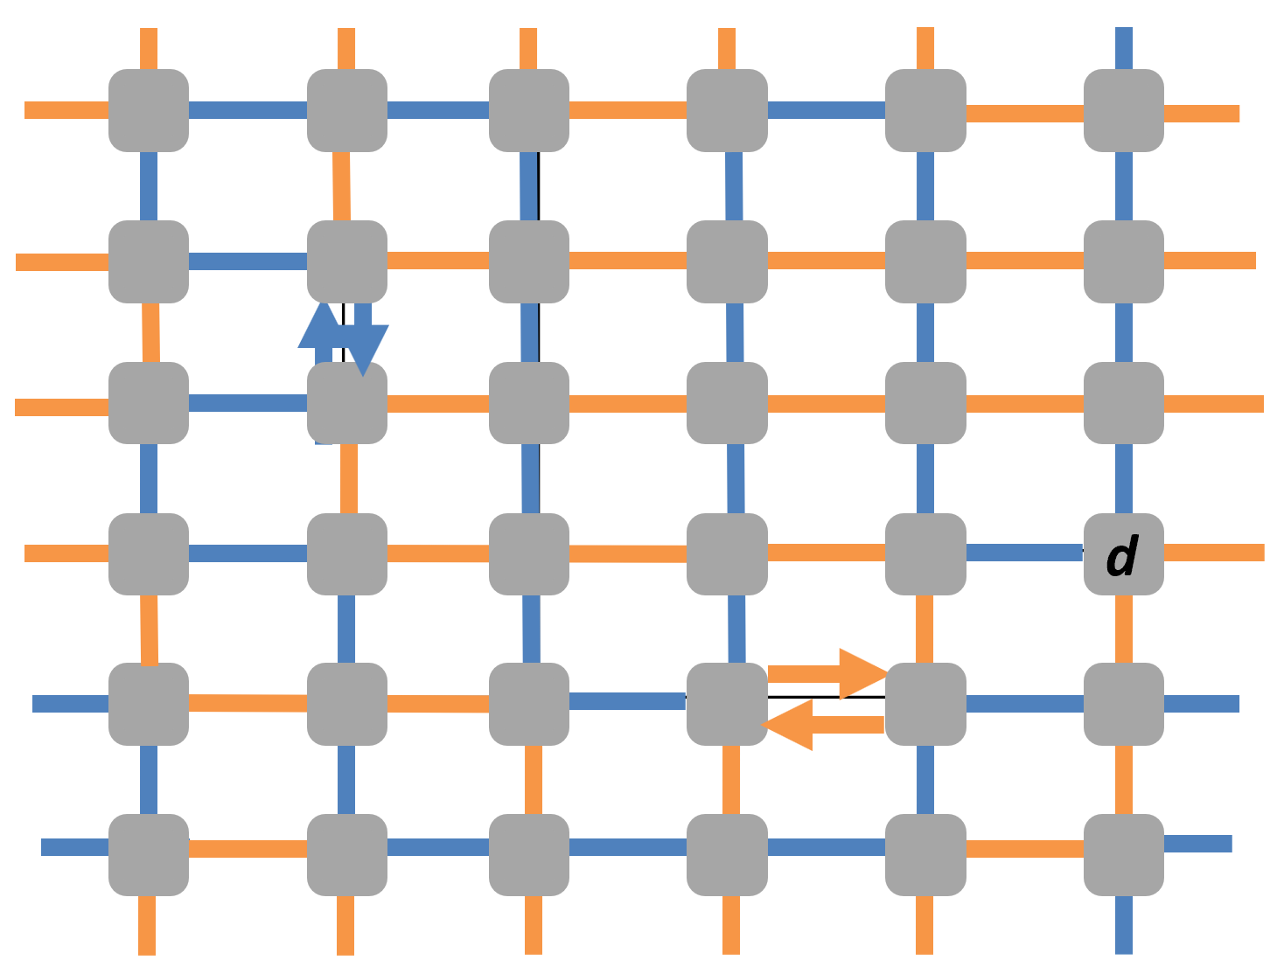
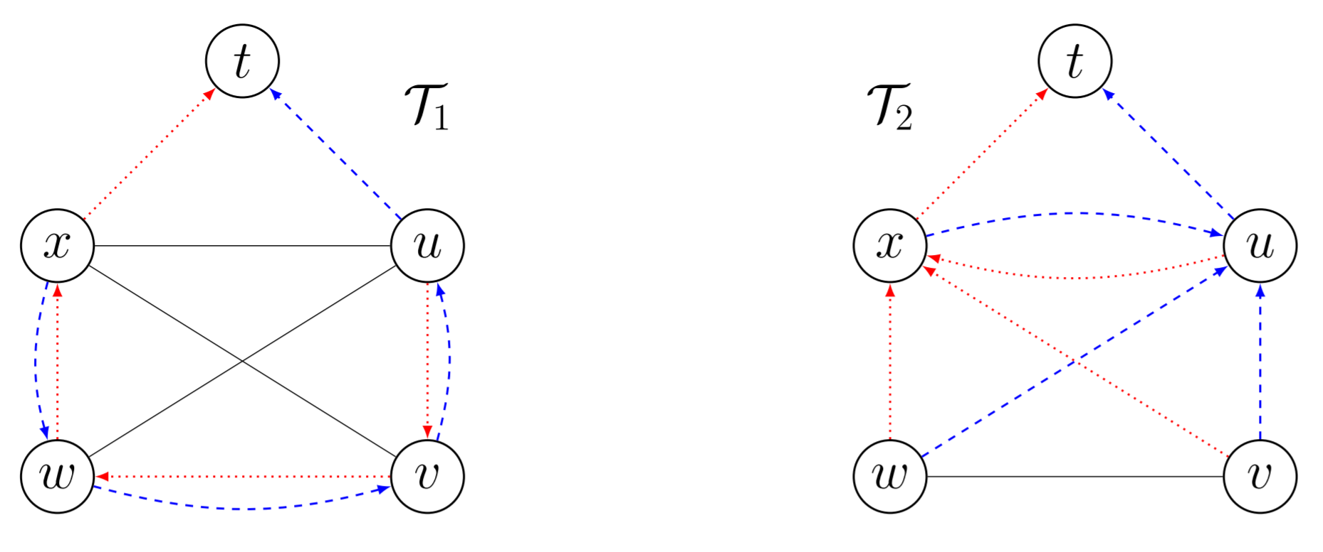
What About Path Length and Stretch?
So far: ignored the length of the failover routes
Hamilton cycles are particularly bad
The heights of general arborescences may be lower
Idea (so far heuristic):
Postprocess the arborescences to lower their heights
Two different t-rooted arc-disjoint spanning arborescence decompositions, T1 and T2
The mean path length of T1 is higher than that of T2
Foerster et al. Improved Fast Rerouting Using Postprocessing (Best Paper Award). 38th International Symposium on Reliable Distributed Systems (SRDS), 2019.

Slide 120
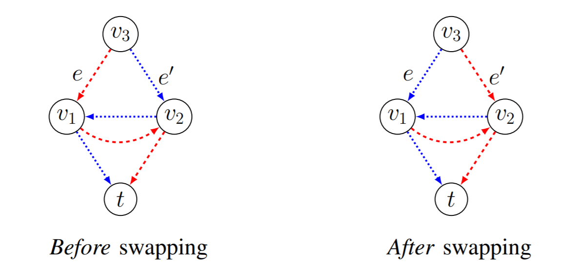
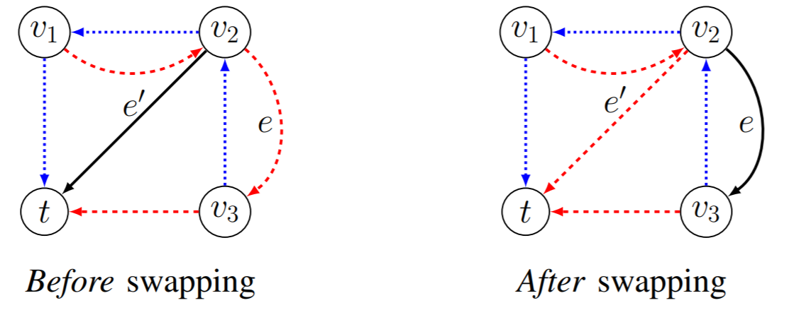
Swapping Operations Which Maintain Decomposition
1
2
60

Slide 121
Roadmap
A Brief History of Resilient Networking
Algorithms for Local Fast Re-Routing (FRR)
Accounting for Congestion
Accounting for Network Policy

Slide 122
Roadmap
A Brief History of Resilient Networking
Algorithms for Local Fast Re-Routing (FRR)
Accounting for Congestion
Accounting for Network Policy
An example with header rewriting.

Slide 123
Case Study: MPLS Networks
Widely deployed networks by Internet Service Providers (ISPs)
Often used for traffic engineering
Avoid congestion by going non-shortest paths
Allows for header re-writing upon failures
Header based on stack of labels
62

Slide 124
How (MPLS) Networks Work
Forwarding based on top label of label stack
v₁
v₂
v₃
v₄
Default routing of
two flows
v₅
v₆
v₇
v₈
63

Slide 125
How (MPLS) Networks Work
Forwarding based on top label of label stack
flow 1
v₁
v₂
v₃
v₄
Default routing of
two flows
flow 2
v₅
v₆
v₇
v₈
63

Slide 126
How (MPLS) Networks Work
Forwarding based on top label of label stack
push
swap
swap
pop
10
20
11
21
in₁
12
v₁
v₂
v₃
v₄
out₁
in₂
Default routing of
two flows
22
v₅
v₆
v₇
v₈
out₂
pop
63

Slide 127
Fast Reroute Around 1 Failure
Forwarding based on top label of label stack (in packet header)
10
20
11
21
in₁
12
v₁
v₂
v₃
v₄
out₁
in₂
Default routing of
two flows
22
v₅
v₆
v₇
v₈
out₂
For failover: push and pop label
10
20
in₁
12
v₁
30|11
30|21
v₃
v₄
out₁
v₂
11
21
One failure: push 30: route around (v₂,v₃)
in₂
22
v₅
v₆
31|11
31|21
v₇
v₈
out₂
63

Slide 128
Fast Reroute Around 1 Failure
Forwarding based on top label of label stack (in packet header)
10
20
11
21
in₁
12
v₁
v₂
v₃
v₄
out₁
in₂
Default routing of
two flows
22
If (v₂,v₃) failed, push 30 and forward to v₆.
v₅
v₆
v₇
v₈
out₂
For failover: push and pop label
in₁
Normal swap
12
v₁
30|11
30|21
v₃
v₄
out₁
v₂
11
21
One failure: push 30: route around (v₂,v₃)
in₂
Pop
22
v₅
v₆
31|11
31|21
v₇
v₈
out₂
63

Slide 129
Fast Reroute Around 1 Failure
Forwarding based on top label of label stack (in packet header)
10
20
11
21
in₁
12
v₁
v₂
v₃
v₄
out₁
in₂
Default routing of
two flows
22
If (v₂,v₃) failed, push 30 and forward to v₆.
v₅
What about multiple link failures?
v₆
v₇
v₈
out₂
For failover: push and pop label
in₁
Normal swap
12
v₁
30|11
30|21
v₃
v₄
out₁
v₂
11
21
One failure: push 30: route around (v₂,v₃)
in₂
Pop
22
v₅
v₆
31|11
31|21
v₇
v₈
out₂
63

Slide 130
2 Failures: Push Recursively
10
20
11
21
in₁
12
v₁
v₂
v₃
v₄
out₁
in₂
22
Original Routing
v₅
v₆
v₇
v₈
out₂
10
20
11
21
in₁
12
v₁
30|11
30|21
v₃
v₄
out₁
One failure: push 30: route around (v₂,v₃)
v₂
11
21
in₂
22
v₅
v₆
31|11
31|21
v₇
v₈
out₂
10
20
Push 30
11
21
in₁
Push 40
12
Two failures:
first push 30: route around (v₂,v₃)
v₁
v₂
v₃
v₄
out₁
40|30|11
40|30|21
11
21
in₂
22
Push recursively 40: route around (v₂,v₆)
v₅
30|11
30|21
v₆
31|11
31|21
v₇
v₈
out₂
pop
pop
64

Slide 131
2 Failures: Push Recursively
10
20
11
21
in₁
12
v₁
v₂
v₃
v₄
out₁
in₂
22
Original Routing
v₅
v₆
v₇
v₈
out₂
10
20
11
21
in₁
12
v₁
30|11
30|21
v₃
v₄
out₁
One failure: push 30: route around (v₂,v₃)
v₂
11
21
in₂
22
But masking links one-by-one can be inefficient: (v₇,v₃,v₈) could be shortcut to (v₇,v₈).
v₅
v₆
31|11
31|21
v₇
v₈
out₂
10
20
11
21
in₁
12
Two failures:
first push 30: route around (v₂,v₃)
v₁
v₂
v₃
v₄
out₁
40|30|11
40|30|21
11
21
in₂
22
Push recursively 40: route around (v₂,v₆)
v₅
30|11
30|21
v₆
31|11
31|21
v₇
v₈
out₂
64

Slide 132
2 Failures: Push Recursively
10
20
11
21
in₁
12
v₁
v₂
v₃
v₄
out₁
in₂
22
Original Routing
v₅
More efficient but also more complex:
Cisco does not recommend using this option!
v₆
v₇
v₈
out₂
10
20
11
21
in₁
12
v₁
30|11
30|21
v₃
v₄
out₁
One failure: push 30: route around (v₂,v₃)
v₂
11
21
in₂
22
But masking links one-by-one can be inefficient: (v₇,v₃,v₈) could be shortcut to (v₇,v₈).
v₅
v₆
31|11
31|21
v₇
v₈
out₂
10
20
11
21
in₁
12
Two failures:
first push 30: route around (v₂,v₃)
v₁
v₂
v₃
v₄
out₁
40|30|11
40|30|21
11
21
in₂
22
Push recursively 40: route around (v₂,v₆)
v₅
30|11
30|21
v₆
31|11
31|21
v₇
v₈
out₂
64

Slide 133
2 Failures: Push Recursively
10
20
11
21
in₁
12
v₁
v₂
v₃
v₄
out₁
in₂
22
Original Routing
v₅
More efficient but also more complex:
Cisco does not recommend using this option!
v₆
v₇
v₈
out₂
10
20
11
21
in₁
12
v₁
30|11
30|21
v₃
v₄
out₁
One failure: push 30: route around (v₂,v₃)
v₂
11
21
in₂
22
But masking links one-by-one can be inefficient: (v₇,v₃,v₈) could be shortcut to (v₇,v₈).
v₅
v₆
31|11
31|21
v₇
v₈
out₂
10
20
11
21
Also note: due to push, header size may grow arbitrarily!
in₁
12
Two failures:
first push 30: route around (v₂,v₃)
v₁
v₂
v₃
v₄
out₁
40|30|11
40|30|21
11
21
in₂
22
Push recursively 40: route around (v₂,v₆)
v₅
30|11
30|21
v₆
31|11
31|21
v₇
v₈
out₂
64

Slide 134

Responsibilities of a Sysadmin
Routers and switches store
list of forwarding rules, and
conditional failover rules.
Sysadmin responsible for:
Reachability: Can traffic from ingress port A reach egress port B?
Loop-freedom: Are the routes implied by the forwarding rules loop-free?
Non-reachability: Is it ensured that traffic originating from A never reaches B?
Waypoint ensurance: Is it ensured that traffic from A to B is always routed via a node C (e.g., a firewall)?
B
A
C
65

Slide 135
Responsibilities of a Sysadmin
Sysadmin responsible for:
Reachability: Can traffic from ingress port A reach egress port B?
Loop-freedom: Are the routes implied by the forwarding rules loop-free?
Non-reachability: Is it ensured that traffic originating from A never reaches B?
Waypoint ensurance: Is it ensured that traffic from A to B is always routed via a node C (e.g., a firewall)?
Reachability?
B
A
C
65

Slide 136
Responsibilities of a Sysadmin
Sysadmin responsible for:
Reachability: Can traffic from ingress port A reach egress port B?
Loop-freedom: Are the routes implied by the forwarding rules loop-free?
Non-reachability: Is it ensured that traffic originating from A never reaches B?
Waypoint ensurance: Is it ensured that traffic from A to B is always routed via a node C (e.g., a firewall)?
No loops?
B
A
C
65

Slide 137

Responsibilities of a Sysadmin
Sysadmin responsible for:
Reachability: Can traffic from ingress port A reach egress port B?
Loop-freedom: Are the routes implied by the forwarding rules loop-free?
Policy: Is it ensured that traffic from A to B never goes via C?
Waypoint ensurance: Is it ensured that traffic from A to B is always routed via a node C (e.g., a firewall)?
Policy ok?
B
A
C
E.g. NORDUnet: no traffic via
Iceland (expensive!).
65

Slide 138

Responsibilities of a Sysadmin
Sysadmin responsible for:
Reachability: Can traffic from ingress port A reach egress port B?
Loop-freedom: Are the routes implied by the forwarding rules loop-free?
Policy: Is it ensured that traffic from A to B never goes via C?
Waypoint enforcement: Is it ensured that traffic from A to B is always routed via a node C (e.g., intrusion detection system or a firewall)?
Waypoint?
B
A
C
E.g. IDS
65

Slide 139


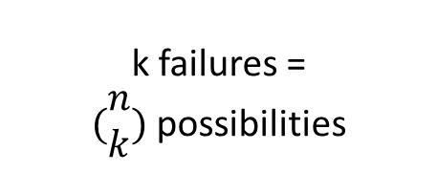
Responsibilities of a Sysadmin
k failures =
$(\begin{matrix}n \\ k\end{matrix})$ possibilities
Sysadmin responsible for:
Reachability: Can traffic from ingress port A reach egress port B?
Loop-freedom: Are the routes implied by the forwarding rules loop-free?
Policy: Is it ensured that traffic from A to B never goes via C?
Waypoint enforcement: Is it ensured that traffic from A to B is always routed via a node C (e.g., intrusion detection system or a firewall)?
B
A
C
E.g. IDS
… and everything even under multiple failures?!
65

Slide 140
Responsibilities of a Sysadmin
k failures =
$(\begin{matrix}n \\ k\end{matrix})$ possibilities
Sysadmin responsible for:
Reachability: Can traffic from ingress port A reach egress port B?
Loop-freedom: Are the routes implied by the forwarding rules loop-free?
Policy: Is it ensured that traffic from A to B never goes via C?
Waypoint enforcement: Is it ensured that traffic from A to B is always routed via a node C (e.g., intrusion detection system or a firewall)?
B
A
C
E.g. IDS
… and everything even under multiple failures?!
Generalization: service chaining!
65

Slide 141
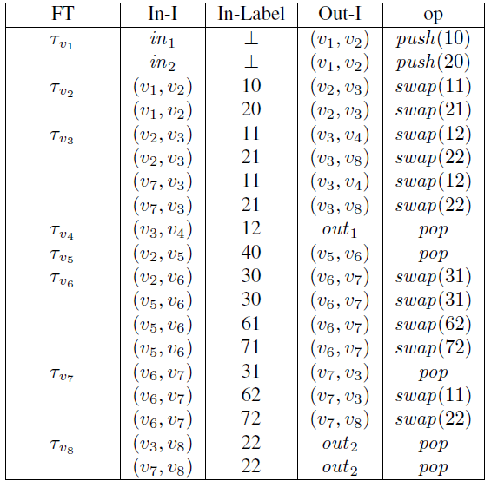

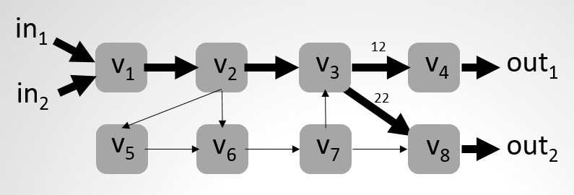
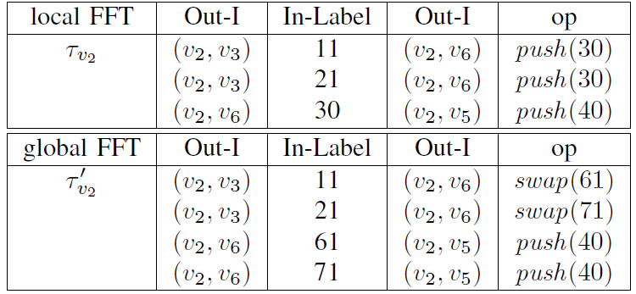
Approach: Automation and Formal Methods
What if...?!
Compilation
pX ⇒ qXX
pX ⇒ qYX
qY ⇒ rYY
rY ⇒ r
rX ⇒ pX
Interpretation
Router configurations
(Cisco, Juniper, etc.)
Pushdown Automaton and Prefix Rewriting Systems
66

Slide 142
Approach: Automation and Formal Methods
Use cases: Sysadmin issues queries to test certain properties, or do it on a regular basis automatically!
What if...?!
Compilation
pX ⇒ qXX
pX ⇒ qYX
qY ⇒ rYY
rY ⇒ r
rX ⇒ pX
Interpretation
Router configurations
(Cisco, Juniper, etc.)
Pushdown Automaton and Prefix Rewriting Systems
Jensen et al. P-Rex: Fast Verification of MPLS Networks with Multiple Link Failures. 14th ACM International Conference on emerging Networking EXperiments and Technologies (CoNEXT), 2018.
17

Slide 143
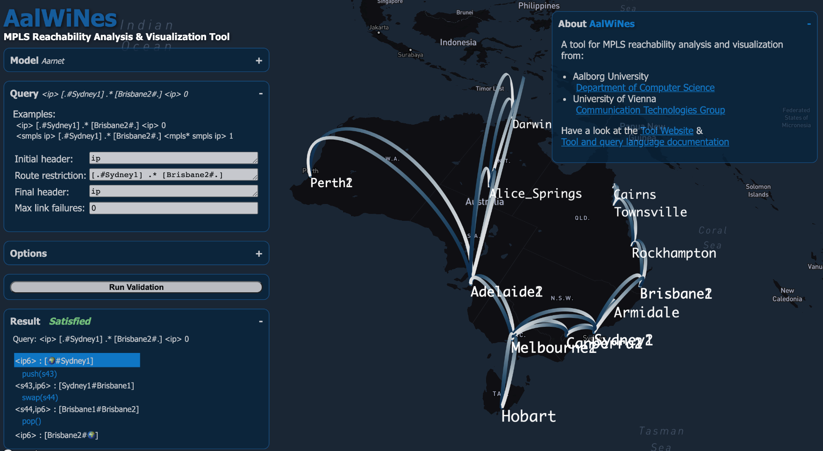
AalWiNes Tool
Query: regular expression
Witness
Dozens of networks
Online demo: https://demo.aalwines.cs.aau.dk/
Source code: https://github.com/DEIS-Tools/AalWiNes
67
31

Slide 144
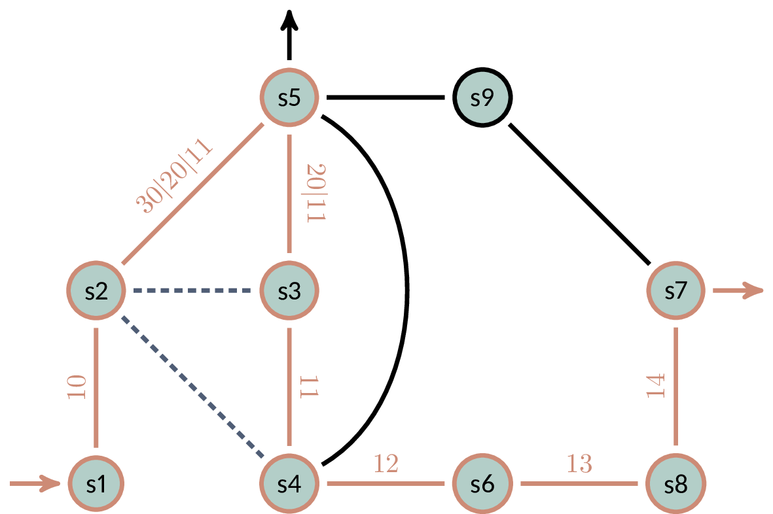
Example
Can traffic starting with [] go through s5, under up to k=2 failures?
stack size!
pop
Query: 3 regular expressions (initial and final header, route)
k=2 [] s1 >> s5 >> s7 []
push
2 failures
pop
YES
(Polynomial time!)
push
68

Slide 145

Why AalWiNes is Fast (Polytime): Automata Theory
For fast verification, we can use the result by Büchi: the set of all reachable configurations of a pushdown automaton a is regular set
We hence simply use Nondeterministic Finite Automata (NFAs) when reasoning about the pushdown automata
The resulting regular operations are all polynomial time
Julius Richard Büchi
1924-1984
Swiss logician
69

Slide 146
AalWiNes
Part 1: Parses query and constructs Push-Down System (PDS)
In Python 3
Part 2: Reachability analysis of constructed PDS
Using Moped tool
Resp. our new weighted extension and much faster implementation in C++.
70

Slide 147
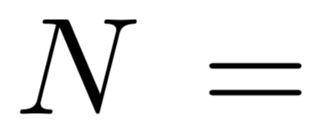
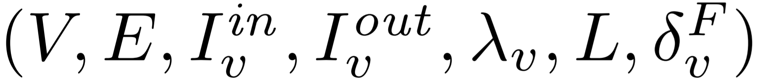
Network Model
Network: a 7-tuple
Outgoing interfaces
Links
Nodes
Set of labels in packet header
Incoming interfaces
71

Slide 148
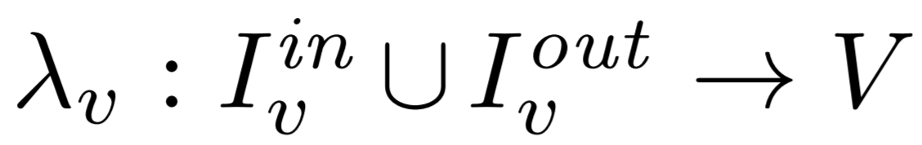
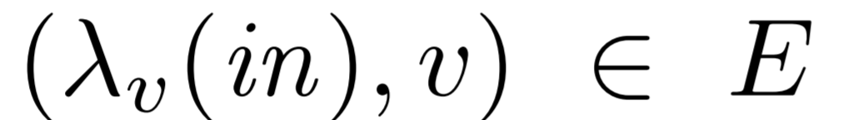
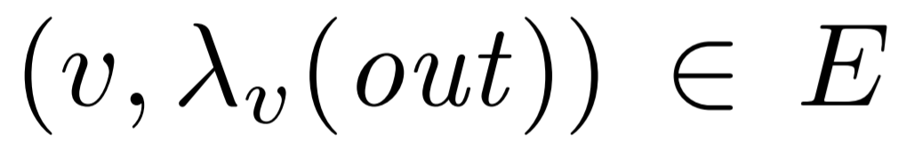
Network Model
Network: a 7-tuple
Interface function: maps outgoing interface to next hop node and incoming interface to previous hop node
That is: and
Interface function
71

Slide 149
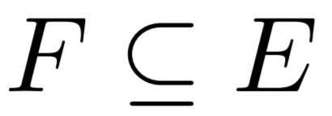
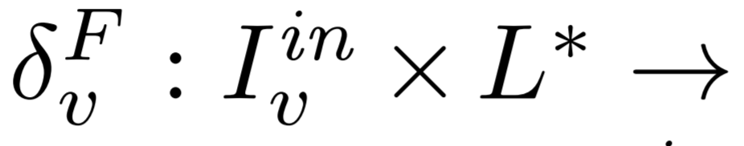
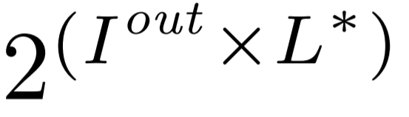
Network Model
Network: a 7-tuple
Routing function: for each set of failed links , the routing function
defines, for all incoming interfaces and packet headers, outgoing interfaces together with modified headers.
Routing function
71

Slide 150
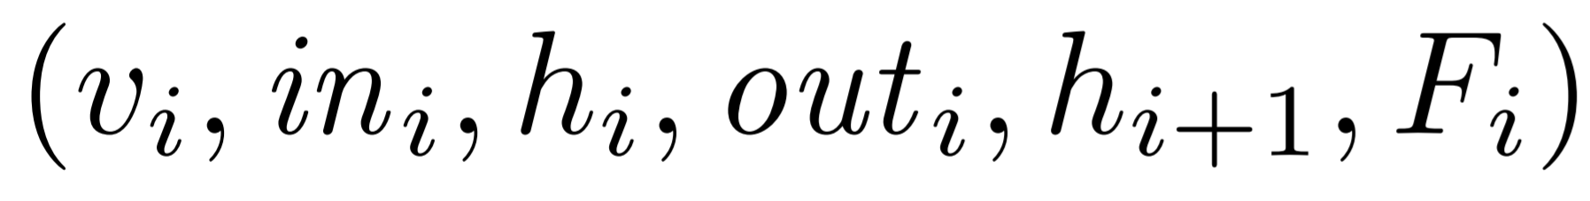
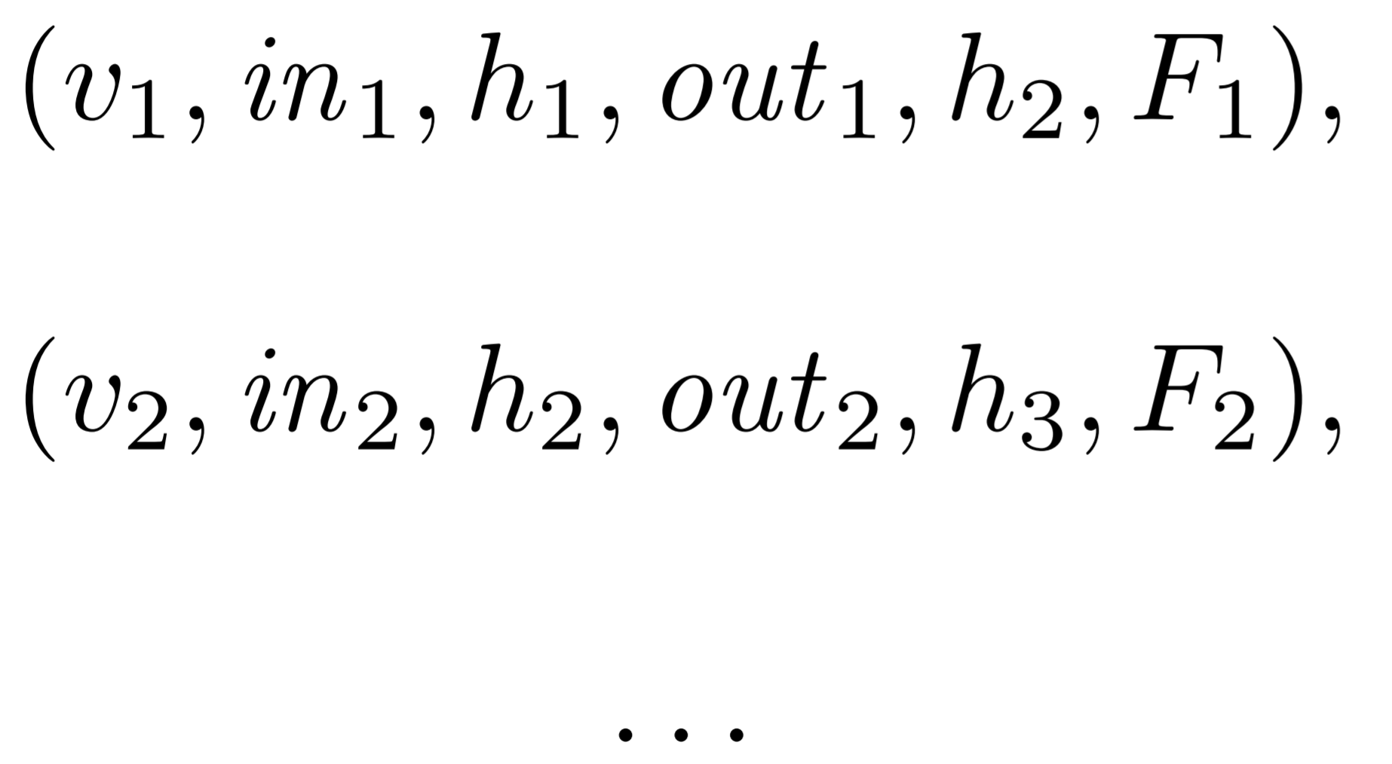

Routing
Packet routing sequence can be represented using sequence of tuples:
… forwards it to live next hop…
… given that these links are down.
… on interface…
Node receives…
… packet with header…
… with new header..
Example: routing (in)finite sequence of tuples
v1
v2
in1
out1
in2
out2
h3
h1
h2
72

Slide 151
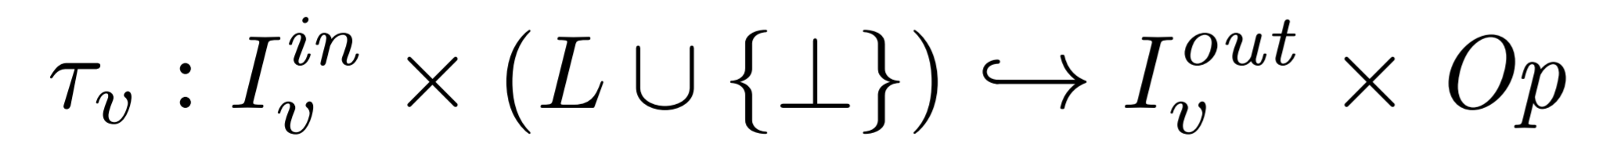
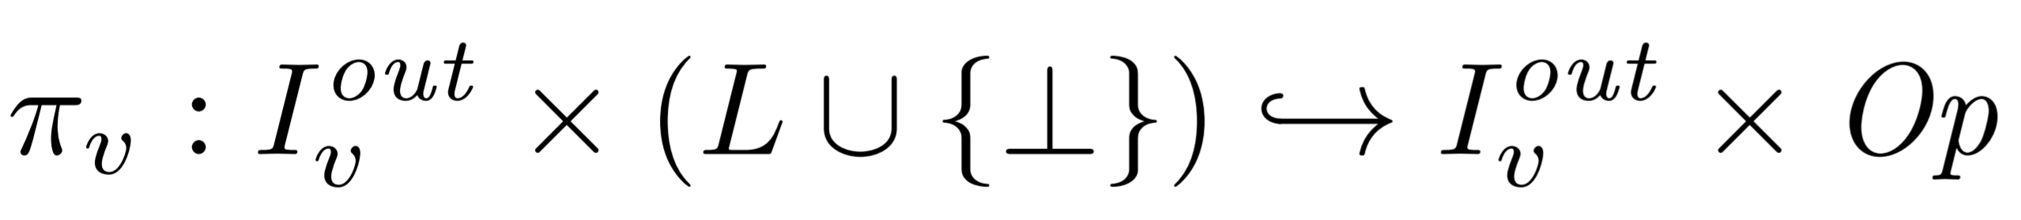
MPLS Network Model
MPLS supports three specific operations on header sequences:
The local routing table can then be defined as
Local link protection function defines backup interface
Interface + label
Maps to next hop and operation
protected
backup
typically: push
73

Slide 152
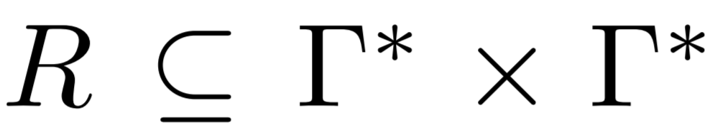
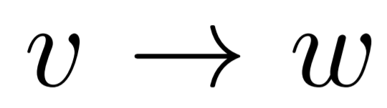
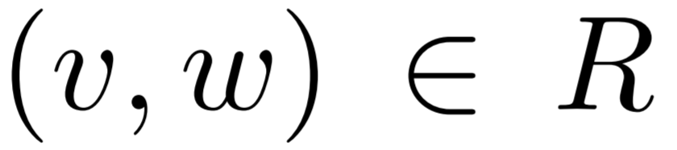
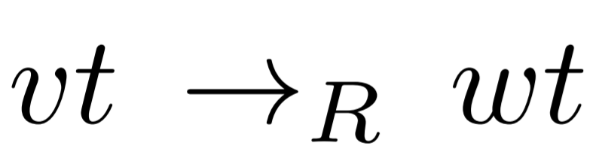
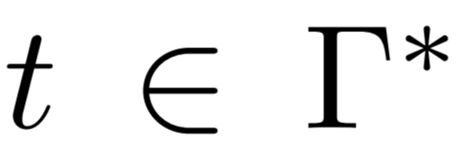
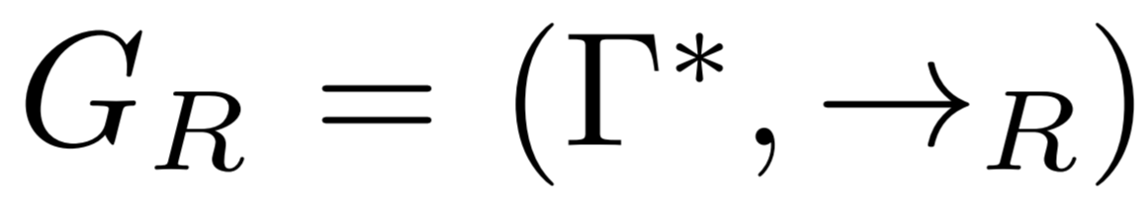
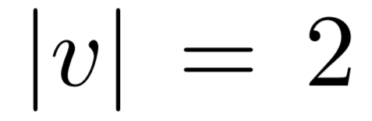
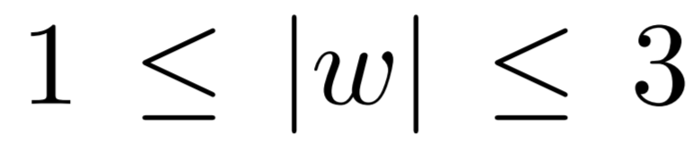
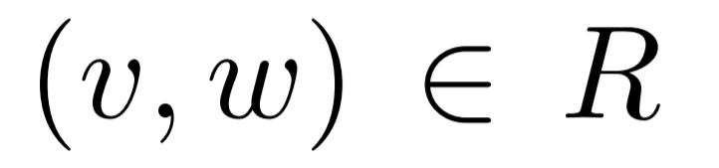
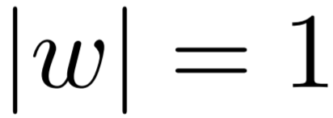
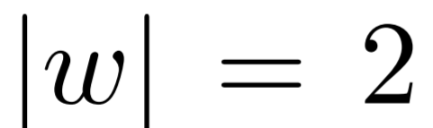
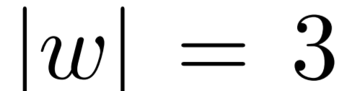
MPLS Prefix Rewriting System
Prefix rewriting system is set of rewriting rules
We will write for :
Prefix rewriting rules: for
generate a transition system
Replace prefix
We call a prefix rewriting system pushdown system if and for all
First symbol of v and w: control state of pushdown system.
pop
Second symbol of v: top of stack label.
swap
push
74

Slide 153
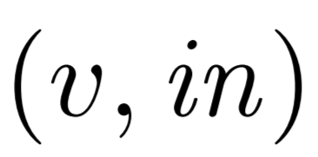
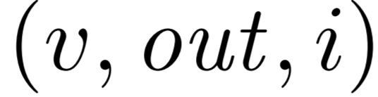






MPLS Prefix Rewriting System
Control states: and
Labels: stack symbols and at bottom
Packet with header arriving at interface in at represented as pushdown configuration:
Packet to be forwarded at node to outgoing interface represented by configuration:
Node and incoming link
How many times have we tried to reroute at this node already?
75

Slide 154
Example Rules: Regular Forwarding on Top-Most Label
Push label on stack
Push:
Swap top of stack
Swap:
Pop top of stack
Pop:
76

Slide 155

Example Failover Rules
Emumerate all rerouting options
Failover-Push:
Failover-Swap:
Failover-Pop:
Example rewriting sequence:
Try default
Try first backup
Try second backup
77

Slide 156

Case Study: NORDUnet
Regional service provider
24 MPLS routers geographically distributed across several countries
Running Juniper operating system
More than 30,000 labels
Ca. 1 million forwarding rules in our model
For most queries of operators: answer within seconds
78

Slide 157



Evaluation in Synthetic Scenarios
For small queries fast: 1000s of links, within seconds
100,000s
1000s
secs
# failures affects performance only linearly!
Bottleneck are large queries
31
79

Slide 158
Generalizes to Quantitative Properties
AalWiNes can also be used to test quantitative properties
If query is satisfied, find trace that minimizes:
Hops
Latency (based on a latency value per link)
Tunnels
Approach: weighted pushdown automata
Fast poly-time algorithms exist also for weighted pushdown automata (area of dataflow analysis)
Indeed, experiments show: acceptable overhead of weighted (quantitative) analysis
Transitions annotated with weights.
80

Slide 159
Conclusion
Fast rerouting requires local decision making
Different fault-tolerance metrics: ideal resilience, perfect resilience
What can be achieved depends on what can be matched locally
Locally balancing load under failures is hard, but randomization helps
81

Slide 160

What About The Control Plane?
Still many open questions too, see e.g., TACAS 2021
82

Slide 161


What About Segment Routing?
See e.g., GI 2018 and OPODIS 2020
82

Slide 162

What About Segment Routing?
t
IGP
IGP Segment
t
s1
s3
L
t
IGP
w1
s
t
s1
s2
s3
w2
w
s
IGP
wt
pop
83

Slide 163
What About Segment Routing?
We need two definitions:
P-Space: the nodes whose shortest path from S does not use L
Q-Space: the nodes whose shortest path to T does not use L
P-Space
Q-Space
w
S
T
L
Idea: choose segment endpoint w at intersection!
84

Slide 164
Two Cases
P-Space and Q-Space: Are connected subgraphs, cover all nodes, overlap or are adjacent
P-Space
Q-Space
Case 1: S can simply push W
w
S
T
L
W
∞
N
Case 2: S pushes W and (W,N), forces packet to enter Q-space
S
T
L
85

Slide 165
TI-LFA Under Double Failure
T
∞
TI-LFA
Loop
N
W
S
∞
87

Slide 166

TI-MFA Under Double Failure
TI-MFA: failure-carrying packets for SR!
T
∞
TI-MFA
N
W
S
∞
minimal info
(S,T) failed
87

Slide 167
TI-MFA Under Double Failure
TI-MFA: failure-carrying packets for SR!
T
∞
TI-MFA
N
W
S
∞
minimal info
(S,T) failed
87

Slide 168
From the viewpoint of the node S where the packet hits another failed link:
Flush the label stack except for the destination T
Based on all link failure info stored in the packet header, compute the segments necessary to reach T and the labels accordingly
Find the last node on ShortestPath(S,T) that a packet can reach from S without hitting known failed link (”repeated TI-LFA on subgraph”)
Let V1 be this node followed by the link (V1,V2) on this path
Set the top of label stack as (V1, (V1,V2),…
Repeat the same for V2 as the start of next segment and keep repeating until the segment that ends with T
Dispatch the packet (it will reach T unless it hits a failure disconnecting the network)

Slide 169
Theorem: TI-MFA tolerates k failures in k-connected network!
Proof:
Invariant: by construction, previously hit failures won’t be hit again
k failures: by construction the backup path will not use any failed link seen previously
Hence, the packet either hits all the k failures or reaches its destination early

Slide 170

Efficient Implementation of FRR?
See e.g., CoNEXT 2019
88

Slide 171
A Recent Survey
per-destination
shortest paths DAGs
equal-split
A Survey of Fast-Recovery Mechanisms in Packet-Switched Networks Marco Chiesa, Andrzej Kamisinski, Jacek Rak, Gabor Retvari, and Stefan Schmid. IEEE Communications Surveys and Tutorials (COMST), 2021.
Notes:
To give you a sense of what it means to leverage SDN-like control in legacy networks I will rely on the following motivating example.

Slide 172
References
On the Feasibility of Perfect Resilience with Local Fast Failover Klaus-Tycho Foerster, Juho Hirvonen, Yvonne-Anne Pignolet, Stefan Schmid, and Gilles Tredan. SIAM Symposium on Algorithmic Principles of Computer Systems (APOCS), Alexandria, Virginia, USA, January 2021.
Brief Announcement: What Can(not) Be Perfectly Rerouted Locally Klaus-Tycho Foerster, Juho Hirvonen, Yvonne-Anne Pignolet, Stefan Schmid, and Gilles Tredan. International Symposium on Distributed Computing (DISC), Freiburg, Germany, October 2020.
Improved Fast Rerouting Using Postprocessing Klaus-Tycho Foerster, Andrzej Kamisinski, Yvonne-Anne Pignolet, Stefan Schmid, and Gilles Tredan. IEEE Transactions on Dependable and Secure Computing (TDSC), 2020.
Resilient Capacity-Aware Routing Stefan Schmid, Nicolas Schnepf and Jiri Srba. 27th International Conference on Tools and Algorithms for the Construction and Analysis of Systems (TACAS), Virtual Conference, March 2021.
AalWiNes: A Fast and Quantitative What-If Analysis Tool for MPLS Networks Peter Gjøl Jensen, Morten Konggaard, Dan Kristiansen, Stefan Schmid, Bernhard Clemens Schrenk, and Jiri Srba. 16th ACM International Conference on emerging Networking EXperiments and Technologies (CoNEXT), Barcelona, Spain, December 2020.
P-Rex: Fast Verification of MPLS Networks with Multiple Link Failures Jesper Stenbjerg Jensen, Troels Beck Krogh, Jonas Sand Madsen, Stefan Schmid, Jiri Srba, and Marc Tom Thorgersen. 14th ACM International Conference on emerging Networking EXperiments and Technologies (CoNEXT), Heraklion/Crete, Greece, December 2018.
Polynomial-Time What-If Analysis for Prefix-Manipulating MPLS Networks Stefan Schmid and Jiri Srba. 37th IEEE Conference on Computer Communications (INFOCOM), Honolulu, Hawaii, USA, April 2018.
per-destination
shortest paths DAGs
equal-split
Notes:
To give you a sense of what it means to leverage SDN-like control in legacy networks I will rely on the following motivating example.

Slide 173
More References
Randomized Local Fast Rerouting for Datacenter Networks with Almost Optimal Congestion Gregor Bankhamer, Robert Elsässer, and Stefan Schmid.. International Symposium on Distributed Computing (DISC), Freiburg, Germany, October 2021.
Bonsai: Efficient Fast Failover Routing Using Small Arborescences Klaus-Tycho Foerster, Andrzej Kamisinski, Yvonne-Anne Pignolet, Stefan Schmid, and Gilles Tredan. 49th IEEE/IFIP International Conference on Dependable Systems and Networks (DSN), Portland, Oregon, USA, June 2019.
CASA: Congestion and Stretch Aware Static Fast Rerouting Klaus-Tycho Foerster, Yvonne-Anne Pignolet, Stefan Schmid, and Gilles Tredan 38th IEEE Conference on Computer Communications (INFOCOM), Paris, France, April 2019.
Load-Optimal Local Fast Rerouting for Dense Networks Michael Borokhovich, Yvonne-Anne Pignolet, Gilles Tredan, and Stefan Schmid. IEEE/ACM Transactions on Networking (TON), 2018.
PURR: A Primitive for Reconfigurable Fast Reroute Marco Chiesa, Roshan Sedar, Gianni Antichi, Michael Borokhovich, Andrzej Kamisinski, Georgios Nikolaidis, and Stefan Schmid. 15th ACM International Conference on emerging Networking EXperiments and Technologies (CoNEXT), Orlando, Florida, USA, December 2019. Artefact Evaluation: Available, Functional, Reusable.
On the Resiliency of Static Forwarding Tables In IEEE/ACM Transactions on Networking (ToN), 2017 M. Chiesa, I. Nikolaevskiy, S. Mitrovic, A. Gurtov, A. Madry, M. Schapira, S. Shenker
per-destination
shortest paths DAGs
equal-split
Notes:
To give you a sense of what it means to leverage SDN-like control in legacy networks I will rely on the following motivating example.

Slide 174

Questions?
Notes:
To give you a sense of what it means to leverage SDN-like control in legacy networks I will rely on the following motivating example.

Slide 175
Backup Slides

Slide 176
Remark: Traditional Approach LFA
Traditionally: forwarding along shortest paths
Loop-Free Alternative (LFA): failover to alternative neighbor, from there shortest path
Example 1:
If (s,v) fails, s can failover to u
u has shortest path to t that does not go through (s,v) again
WORKS: can protect (s,v)
Example 1:
Can Protect
s
u
v
t
Initial Path
LFAFRR
17

Slide 177
Remark: Traditional Approach LFA
Traditionally: forwarding along shortest paths
Loop-Free Alternative (LFA): failover to alternative neighbor, from there shortest path
Example 2:
If (s,t) fails, s can only try to failover to v
However, when v‘s shortest route to t goes along s again: loop
DOES NOT WORK: Cannot protect (s,t)
Initial Path
LFAFRR
Example 2:
non-LFAFRR
Cannot protect
s
t
v
can’t use it!
17

Slide 178
Remark: Traditional Approach LFA
Traditionally: forwarding along shortest paths
Loop-Free Alternative (LFA): failover to alternative neighbor, from there shortest path
Example 2:
If (s,t) fails, s can only try to failover to v
However, when v‘s shortest route to t goes along s again: loop
DOES NOT WORK: Cannot protect (s,t)
Initial Path
LFAFRR
Example 2:
non-LFAFRR
Cannot protect
s
t
v
can’t use it!
Even though loop-free alternative path exists, an LFA algorithm cannot use it. Protection ratio of LFA depends on topology.
17

